Slide 1
DBS201: Data Modeling
Lecture 2

Slide 2
Agenda
Data Modeling
Types of Models
Entity Relationship Model

Slide 3
Data Modeling
A representation, usually graphical, of complex real-world data structures – organizes data for various users
Communications tool to facilitate interaction between designers, application programmers and the end users
Good database design uses an appropriate data model as its foundation

Slide 4
Data Modeling
Model shows the data that is collected and stored, its characteristics and the relationships between the data

Slide 5
Agenda
Data Modeling
Types of Models
Entity Relationship Model

Slide 6
Types of Models
Evolution of Data Models:
  Hierarchical
  Network
  Relational
  Object Oriented

Slide 7
Types of Models
Hierarchical Model:
  Basic concepts of this model formed the basis for subsequent database development
  Based on a parent/child relationship
  Each parent can have many children
  Each child can have only one parent
  Similar to a tree structure:
    Tree is defined by path that traces parent segments to child segments, beginning from top left

Slide 8
Types of Models
Hierarchical Model:
  Advantages:
    Conceptual simplicity
    Efficient
  Disadvantages
    Complex implementation
    Complex applications programming and use
    Implementation limitations

Slide 9
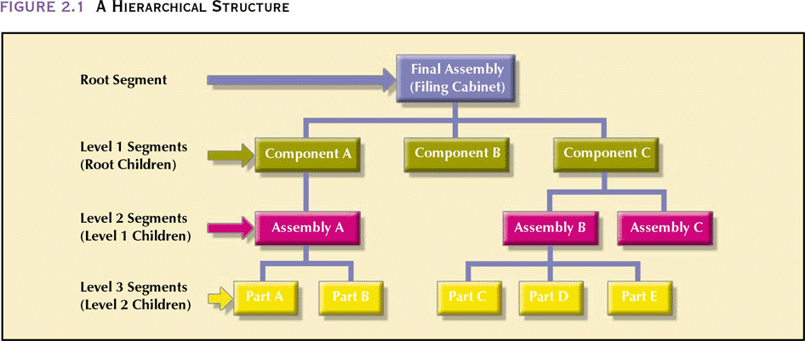
Types of Models

Slide 10
Types of Models
Network Model
  Represents complex data relationships more effectively
  Improved database standard
  Based on a parent/child relationship
  Each parent can have many children
  Each child can have more than one parent

Slide 11
Types of Models
Network Model:
  Advantages:
    Conceptual simplicity
    Handles more relationship types
  Disadvantages
    Complex implementation
    Complex applications programming and use

Slide 12
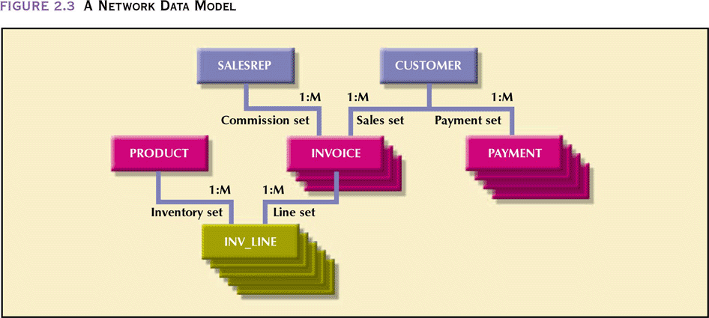
Types of Models

Slide 13
Types of Models
Relational Model
  Performs basic functions provided by both hierarchical and network models
  Based on tables (resembles a file)
    Columns represent fields
    Rows represent records
    Tables are related based on a common field

Slide 14
Types of Models
Relational Model
  Advantages:
    Structural independence
    Improved conceptual simplicity
    Easier database design, implementation, and use
    Ad hoc capability
  Disadvantages:
    Substantial hardware and software overhead
    Can facilitate poor design and implementation

Slide 15
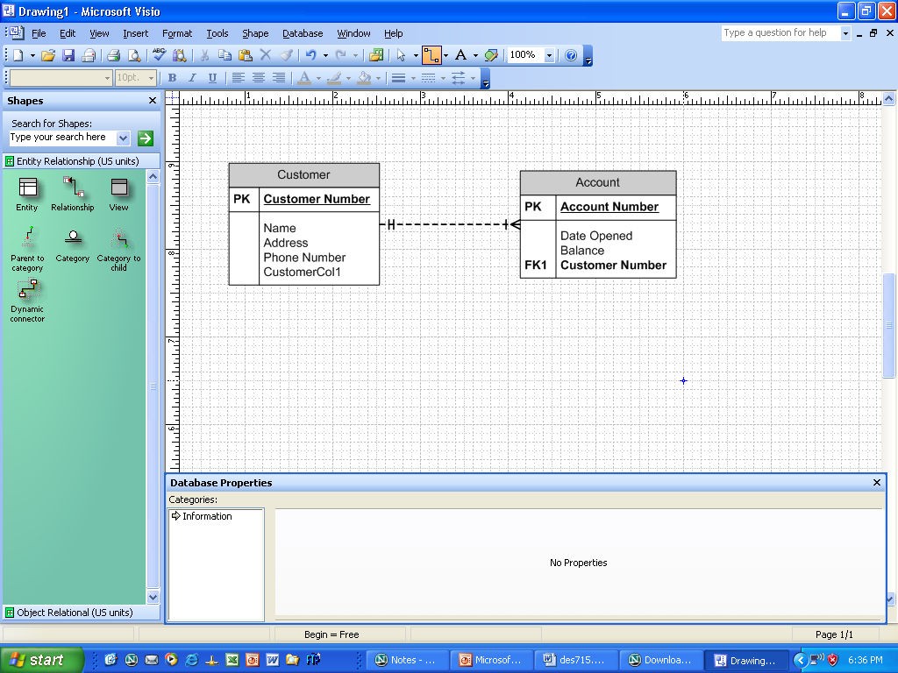
Types of Models
Relational Model

Slide 16
Types of Models
Object Oriented
  Similar to relational model
  Models objects (not tables)
  Objects contain operations too (not just field names)
  Objects that have similar characteristics are grouped into classes

Slide 17
Types of Models
Object Oriented
  Classes are organized in a class hierarchy
  Allows for inheritance (ability for an object within a class hierarchy to inherit the attributes and methods of classes above it)

Slide 18
Types of Models
Object Model
  Advantages:
    Significant code reusability
    Allows for complex data types
    Supports sophistications transaction and information requirements
    Improved conceptual simplicity
  Disadvantages:
    Complex navigational access
    Steep learning curve

Slide 19
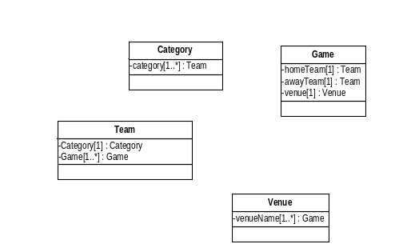
Types of Models
Sample OO Model (without operations/methods)

Slide 20
Agenda
Data Modeling
Types of Models
Entity Relationship Model

Slide 21
Entity Relationship Model
The first step in database design is to gather requirements
Done through:
  Interviews with end-users/management
  Reviewing application documentation done by a business/systems analyst
  Review existing documentation
    GUI interfaces
    Existing reports/documents

Slide 22
Entity Relationship Model
Need to clearly understand user’s data requirements
Need to understand the business rules that affect the data
Need to create a model to reflect what requirements have been gathered – Entity Relationship Model

Slide 23
Entity Relationship Model
A representation, usually graphical, of complex real-world data structures – organizes data for various users
Communications tool to facilitate interaction between designers, application programmers and the end users

Slide 24
Entity Relationship Model
Entity Relationship Diagram (ERD): graphical representation of the Entity Relationship Model
ERD:
  Shows entities
  Entity is mapped to a relational table
  Entity instance (or occurrence) is a row in a table
  Connectivity between entities show types of relationships
More than one type of ERD models exists

Slide 25
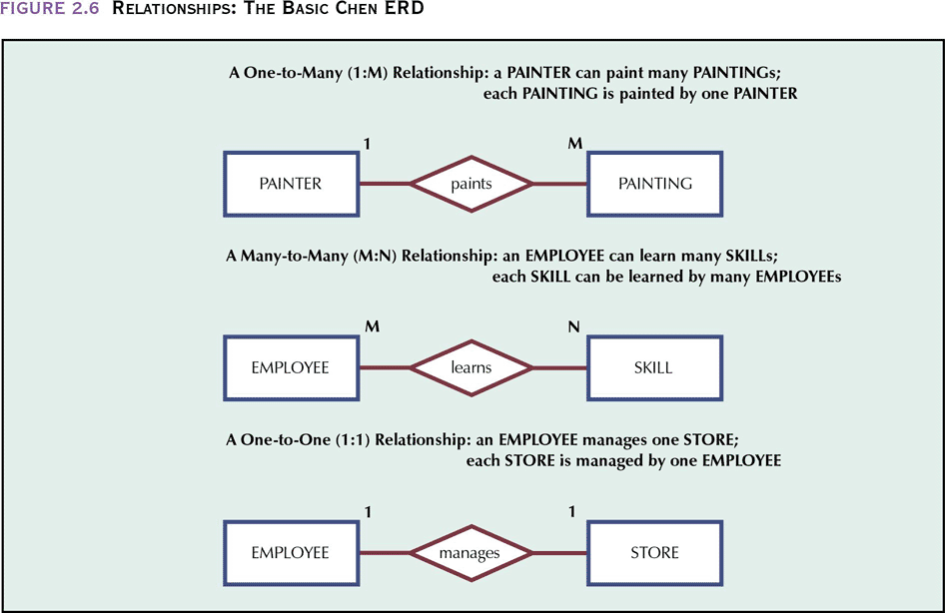
Entity Relationship Model
Chen ERD

Slide 26
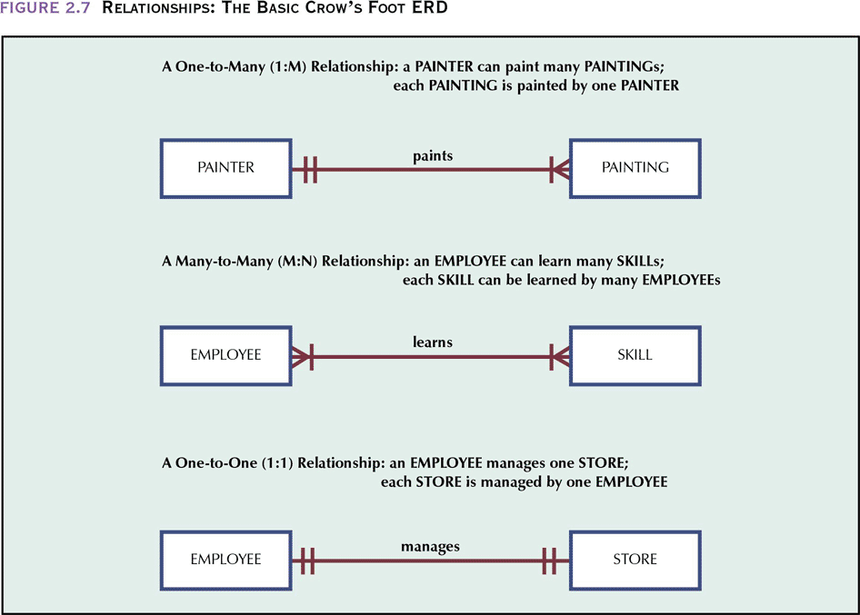
Entity Relationship Model
Crow’s Foot ERD

Slide 27
Entity Relationship Model
ERD is a Conceptual Model
  Represents a global view of the database
  Basis for identification and description of main entities
    May or may not contain fields names, keys
Advantages
  Easy to understand the data environment
  Independent of both software and hardware
  Changes in either the hardware or software have not effect on the database design at the conceptual level

Slide 28
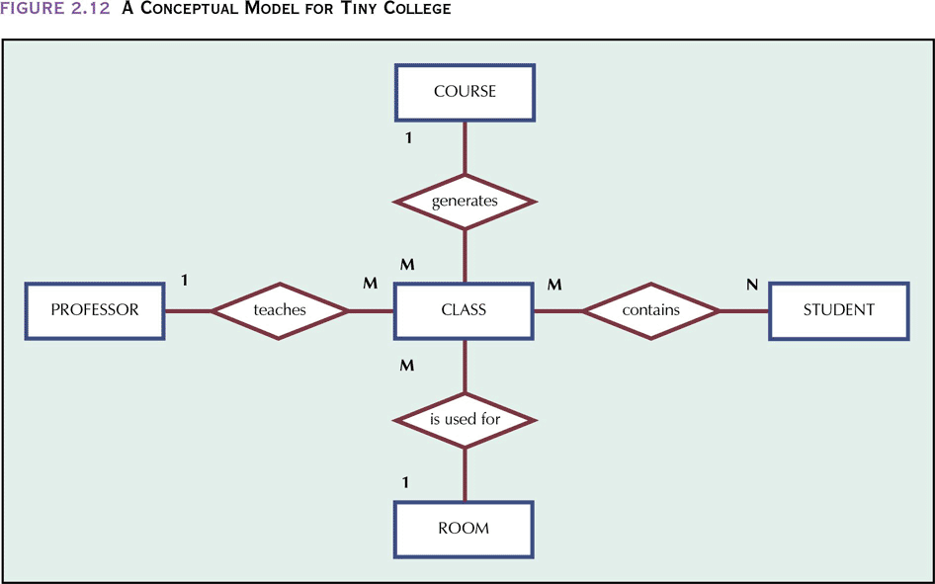
Entity Relationship Model
Conceptual Model

Slide 29
Physical Model
Software and hardware dependent
Need to have a detailed knowledge of both the hardware and software used to implement database design

